Slide 1
Mind the class weight bias: weighted maximum mean discrepancy for unsupervised domain adaptation
Hongliang Yan 2017/06/21

Slide 2
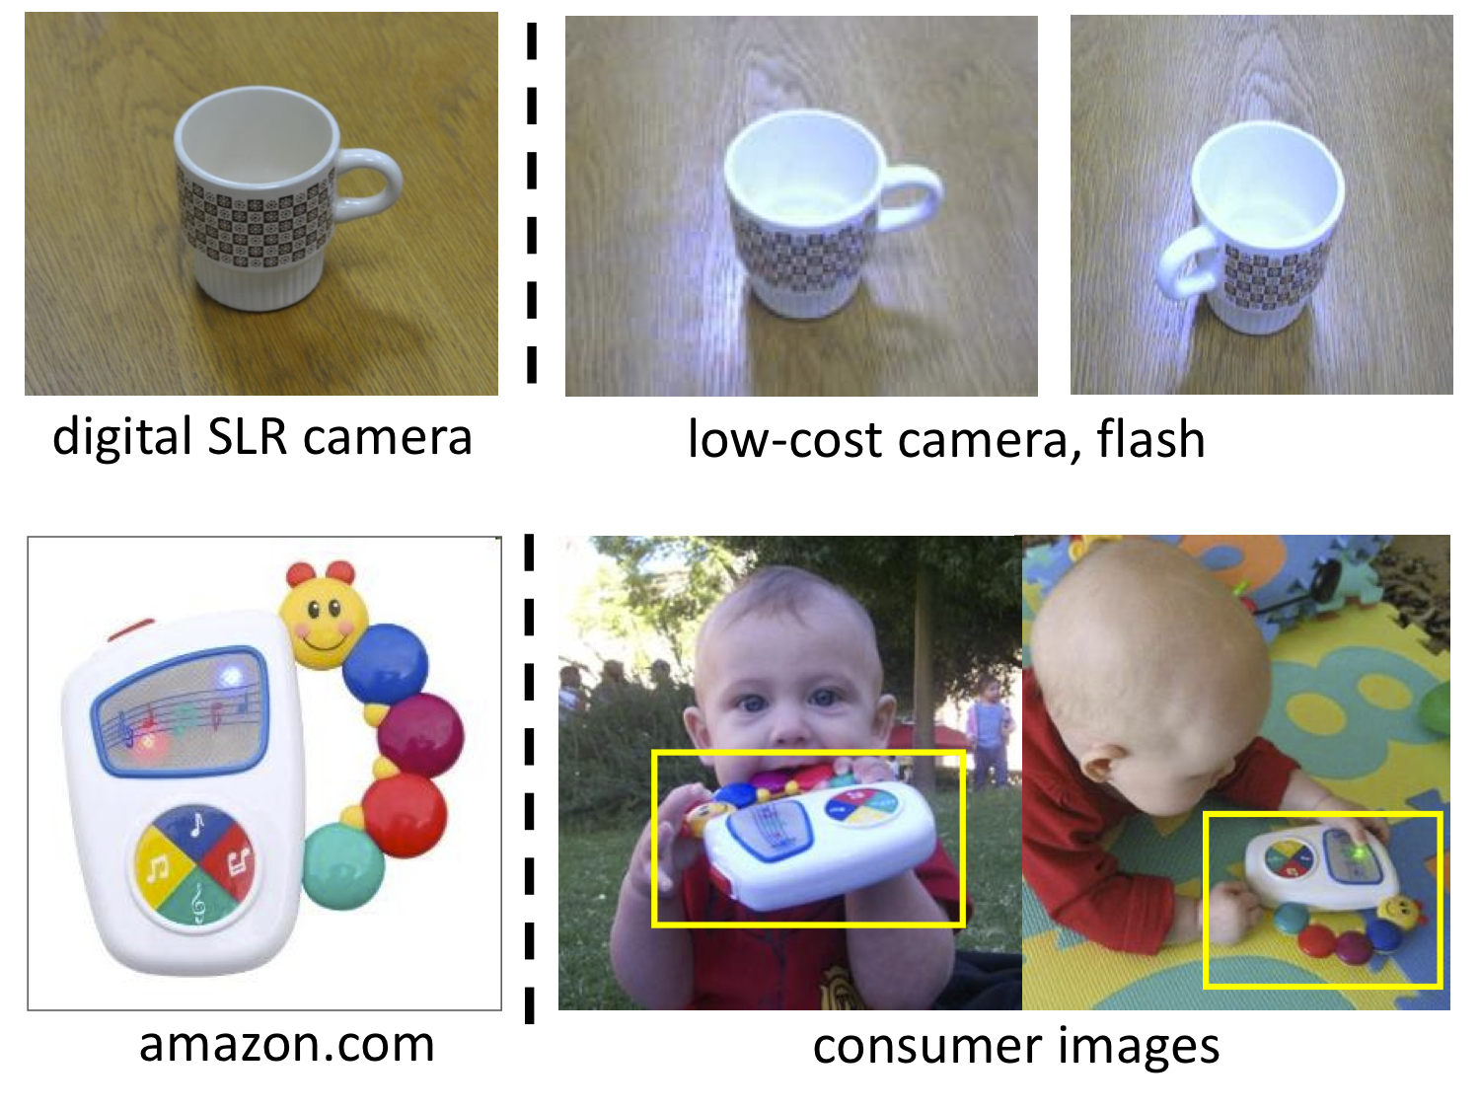
Domain Adaptation
Problem:
Training (Source）
DA
Test
(Target)
Training and test sets are related but under different distributions.
Methodology:
Learn feature space that combine discriminativeness and domain invariance.
minimize
source error
+
domain discrepancy
Figure 1. Illustration of dataset bias.
[1]https://cs.stanford.edu/~jhoffman/domainadapt/

Slide 3
Maximum Mean Discrepancy (MMD)
representing distances between distributions as distances between mean embeddings of features
An empirical estimate

Slide 4
Motivation
Class weight bias cross domains remains unsolved but ubiquitous

Slide 5
Motivation
Class weight bias cross domains remains unsolved but ubiquitous

Slide 6
Motivation
Class weight bias cross domains remains unsolved but ubiquitous
Effect of class weight bias should be removed:
Changes in sample selection criteria

Slide 7
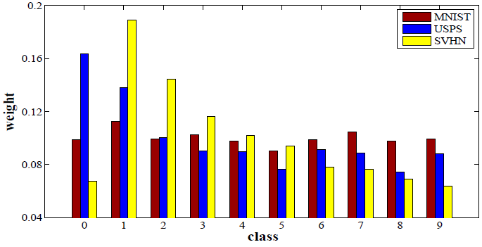
Motivation
Class weight bias cross domains remains unsolved but ubiquitous
Effect of class weight bias should be removed:
Changes in sample selection criteria
Figure 2. Class prior distribution of three digit recognition datasets.

Slide 8
Motivation
Class weight bias cross domains remains unsolved but ubiquitous
Effect of class weight bias should be removed:
Changes in sample selection criteria
Applications are not concerned with class prior distribution

Slide 9
Motivation
Class weight bias cross domains remains unsolved but ubiquitous
Effect of class weight bias should be removed:
Changes in sample selection criteria
Applications are not concerned with class prior distribution
MMD can be minimized by either learning domain invariant representation or preserving the class weights in source domain.

Slide 10
Weighted MMD
Main idea: reweighting classes in source domain so that they have the same class weights as target domain
Introducing an auxiliary weight for each class c in source domain

Slide 11
Weighted MMD
Main idea: reweighting classes in source domain so that they have the same class weights as target domain
Introducing an auxiliary weight for each class c in source domain

Slide 12
Weighted DAN
Replace MMD with weighted MMD item in DAN[4]:
[4] Long M, Cao Y, Wang J. Learning Transferable Features with Deep Adaptation Networks[J]., 2015.

Slide 13
Weighted DAN
Replace MMD with weighted MMD item in DAN[4]:
[4] Long M, Cao Y, Wang J. Learning Transferable Features with Deep Adaptation Networks[J]., 2015.

Slide 14
Weighted DAN
Replace MMD with Weighted MMD item in DAN[4]:
To further exploit the unlabeled data in target domain, empirical risk is considered as semi-supervised model in [5]:
[4] Long M, Cao Y, Wang J. Learning Transferable Features with Deep Adaptation Networks[J]., 2015.
[5] Amini, Massih-Reza, and Patrick Gallinari. "Semi-supervised logistic regression." Proceedings of the 15th European Conference on Artificial Intelligence. IOS Press, 2002.

Slide 15
Optimization: an extension of CEM[6]
Parameters to be estimated including three parts, i.e.,
The model is optimized by alternating between three steps :
E-step:
Fixed W, estimating the class posterior probability of target samples:
[7] Celeux, Gilles, and Gérard Govaert. "A classification EM algorithm for clustering and two stochastic versions." Computational statistics & Data analysis 14.3 (1992): 315-332.

Slide 16
Optimization: an extension of CEM[6]
Parameters to be estimated including three parts, i.e.,
The model is optimized by alternating between three steps :
E-step:
Fixed W, estimating the class posterior probability of target samples:
C-step:
Assign the pseudo labels on target domain:
update the auxiliary class-specific weights for source domain:
is an indictor function which equals 1 if x = c, and equals 0 otherwise.
[7] Celeux, Gilles, and Gérard Govaert. "A classification EM algorithm for clustering and two stochastic versions." Computational statistics & Data analysis 14.3 (1992): 315-332.

Slide 17
Optimization: an extension of CEM[6]
Parameters to be estimated including three parts, i.e.,
The model is optimized by alternating between three steps :
M-step:
Fixed and , updating W. The problem is reformulated as:
The gradient of the three items is computable and W can be optimized by using a mini-batch SGD.
[7] Celeux, Gilles, and Gérard Govaert. "A classification EM algorithm for clustering and two stochastic versions." Computational statistics & Data analysis 14.3 (1992): 315-332.

Slide 18
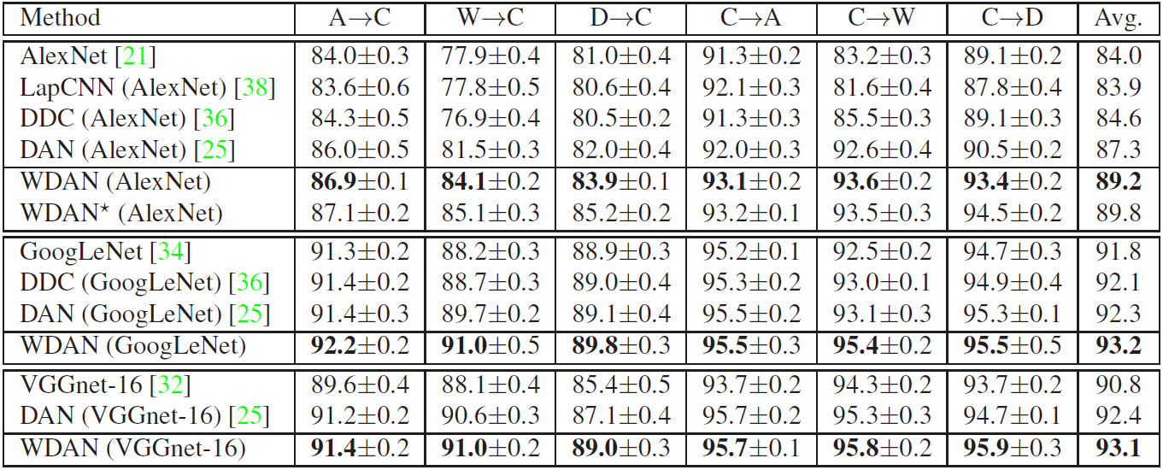
Experimental results
Comparison with state-of-the-arts
Table 1. Experimental results on office-10+Caltech-10

Slide 19
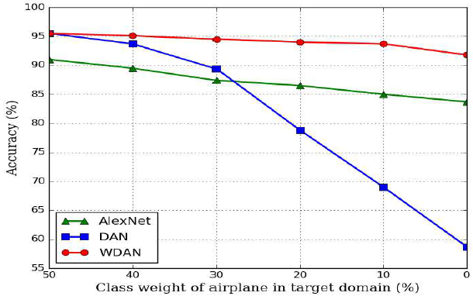
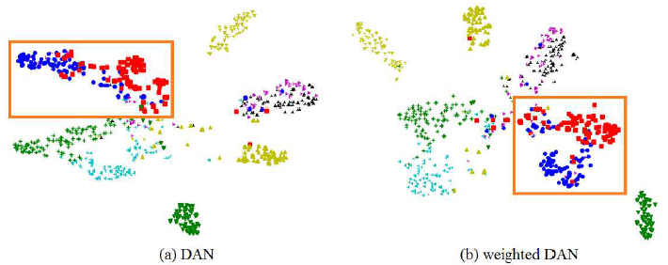
Experimental results
Empirical analysis
Figure 3. Performance of various model under different class weight bias.
Figure 4. Visualization of the learned features of DAN and weighted DAN.

Slide 20
Summary
Introduce class-specific weight into MMD to reduce the effect of class weight bias cross domains.
Develop WDAN model and optimize it in an CEM framework.
Weighted MMD can be applied to other scenarios where MMD is used for distribution distance measurement, e.g., image generation

Slide 21
Thanks!
Paper & code are available
Paper: https://arxiv.org/abs/1705.00609
Code: https://github.com/yhldhit/WMMD-Caffe

